Slide 1


GLOBAL BROADBAND HEALTH DASHBOARD
AZURE MIGRATION PROPOSAL
Prepared for: Accenture
Date: 7/19/2020
Notes:
Drag Picture and Send to Back

Slide 2
CONTENTS
Project Background – What we heard?
Proposed Approach
Technical Architecture
Estimates
Next Steps

Slide 3
GBHD PROJECT BACKGROUND - WHAT WE HEARD
EVOLVE FROM HISTORICAL DASHBOARD TO PREDICTIVE BROADBOND CONSUMPTION USAGE
WHAT WE HEARD
NEED TO BE IN PRODUCTION BY APRIL 2021
MIGRATE TO AZURE ANALYTIC SERVICES
NEED SUPPORT (AZURE) TO AUGMENT INTERNAL CAPACITY AND PROCESS SMEs
Notes:
To be more predictive about the WAN and wireless consumption.

Slide 4
CAP To Azure – FY21
Legend:
On schedule
Minor Delay
Major Delay
Milestone
Not Started
Completed
 | Q1 – FY21 |  |  |  |  |  |  |  |  |  |  |  | Q2 – FY21 |  |  |  |  |  |  |  |  |  |  |  | Q3 – FY21 |  |  |  |  |  |  |  |  |  |  |  | Q4 – FY21
Work Area | Sept |  |  |  | Oct |  |  |  | Nov |  |  |  | Dec |  |  |  | Jan |  |  |  | Feb |  |  |  | Mar |  |  |  | Apr |  |  |  | May |  |  |  | Jun |  |  |  | Jul |  |  |  | Aug
From CAP to Azure LitC
Data Lake Build
Data Lake Ready
Data Ingestion
Transformation
Visualization
UAT
CAP Migration - GBHD
CAP Migration Complete
CAP Migration - SNOW
Data Ingestion
Transformation
UAT
Data Ingestion
Transformation
Visualization
UAT
Cloud 1.0 - Wireless
Viz Upg - SNOW
Incident Mgmt
Change Mgmt
Problem Mgmt
RITM
Firewall UX
Viz Upg - Pulse
Incident UAT
Change UAT
Problem UAT
RITM UAT
Firewall UX UAT
UAT
PulseSecure
UAT
Viz Upg – Device LC
DLC
Viz Upg - IPAM
IPAM
UAT
New Ingestions + PoCs Envs.
Ingestions – Event Grid
UAT
UAT
Pilots
IPAM/Logs TBD
IP Address Mapping and Chargeback
CAP Migration
Viz - Upgrade
Data Ingestion
Transformation
UAT
Visualization
UAT
Critical Applications need to move out of CAP by March 2021

Slide 5
Project Resource Estimates CAP and Cloud 1.0 to Cloud 2.0 (Azure) Migration
Payroll - Expense Description |  | FTE - FY21
Resource Enterprise ID / TBD | Resource Type | SEP 2020 | OCT 2020 | NOV 2020 | DEC 2020 | JAN 2021 | FEB 2021 | MAR 2021 | APR 2021 | MAY 2021 | JUN 2021 | JUL 2021 | AUG 2021
PM | 8-Consultant | 1 | 1 | 1 | 0.75 | 1 | 1 | 1 | 0.5 | 0.5 | 0.25 | 0.25
Microsoft SME | 9-Consultant | 0.5 | 1 | 1 | 0.5 | 1 | 1 | 1 | 0.5 | 0.5
Developer | 10-Analyst - | 1 | 1 | 1 | 0.5 | 1 | 1 | 1 | 1 | 1 | 1 | 1
Data Engineer | 10-Analyst | 2 | 2 | 2 | 1 | 2 | 2 | 2 | 2 | 1 | 1 | 1
Visualization | 10-Analyst | 2 | 3 | 3 | 1.5 | 3 | 3 | 2 | 1 | 1 | 1
Data Arch. | 9-Consultant | 0.5 | 1 | 1 | 0.5 | 1 | 1 | 0.5 | 0.5
Operations | 10-Analyst |  |  |  |  |  | 1 | 1 | 1 | 1 | 1 | 1 | 1
Resource Plan - Total |  | 7 | 9 | 9 | 4.75 | 9 | 10 | 8.5 | 6.5 | 5 | 4.25 | 3.25 | 1
Start Date Sep 2020
Applications in Scope :
Global Bandwidth
ServiceNow and
IP Address Mapping
Cloud 1.0 Applications / Dashboard
70% of resources will be focused on CAP Migration and 30% on Cloud 1.0 migration

Slide 6

PROPOSED APPROACH

Slide 7




ENGAGEMENT PHILOSOPHY
TOOLS
TALENT
TEAMING
DISCOVERY
CONVERSION
MIGRATION
SYNCHRONIZATION
ANALYSIS
IMPLEMENTATION
MODERNIZATION
OPTIMIZATION
COLLABORATE WITH CLIENT SMEs
DEFINE SUCCESS CRITRIA
REMOVE IMPEDEIMENTS
KNOWLEDGE SHARING

Slide 8





PHASED DELIVERY APPROACH
IMPLEMENTATION PHASE
INTEGRATION AND TESTING
2 Weeks Sprinting
Backlog refining
Azure Data lake, Databricks in place
Integrate the downstream applications
Integrate Power BI, Qlik
Integration testing and UAT
Discovery Phase
AUTOMATION AND VALIDATION PHASE
RELEASE
1-3 Weeks
Backlog, Non Functional Requirements,
Capture Benchmarks
Release Planning
Automate pipelines with Azure DevOps
Production planning and hardening
Documentation and Enablement
Production Release
Data processing on Azure Databricks
Notes:
Can we share previous experience with such work (Hortonworks to Azure Databricks)?
PILOT PHASE – SUCCESS CRITERIA
ADD EXTRA SLIDE – NEXT STEPS (RIGHT AT THE END)

Slide 9
TECHNICAL ARCHITECTURE

Slide 10
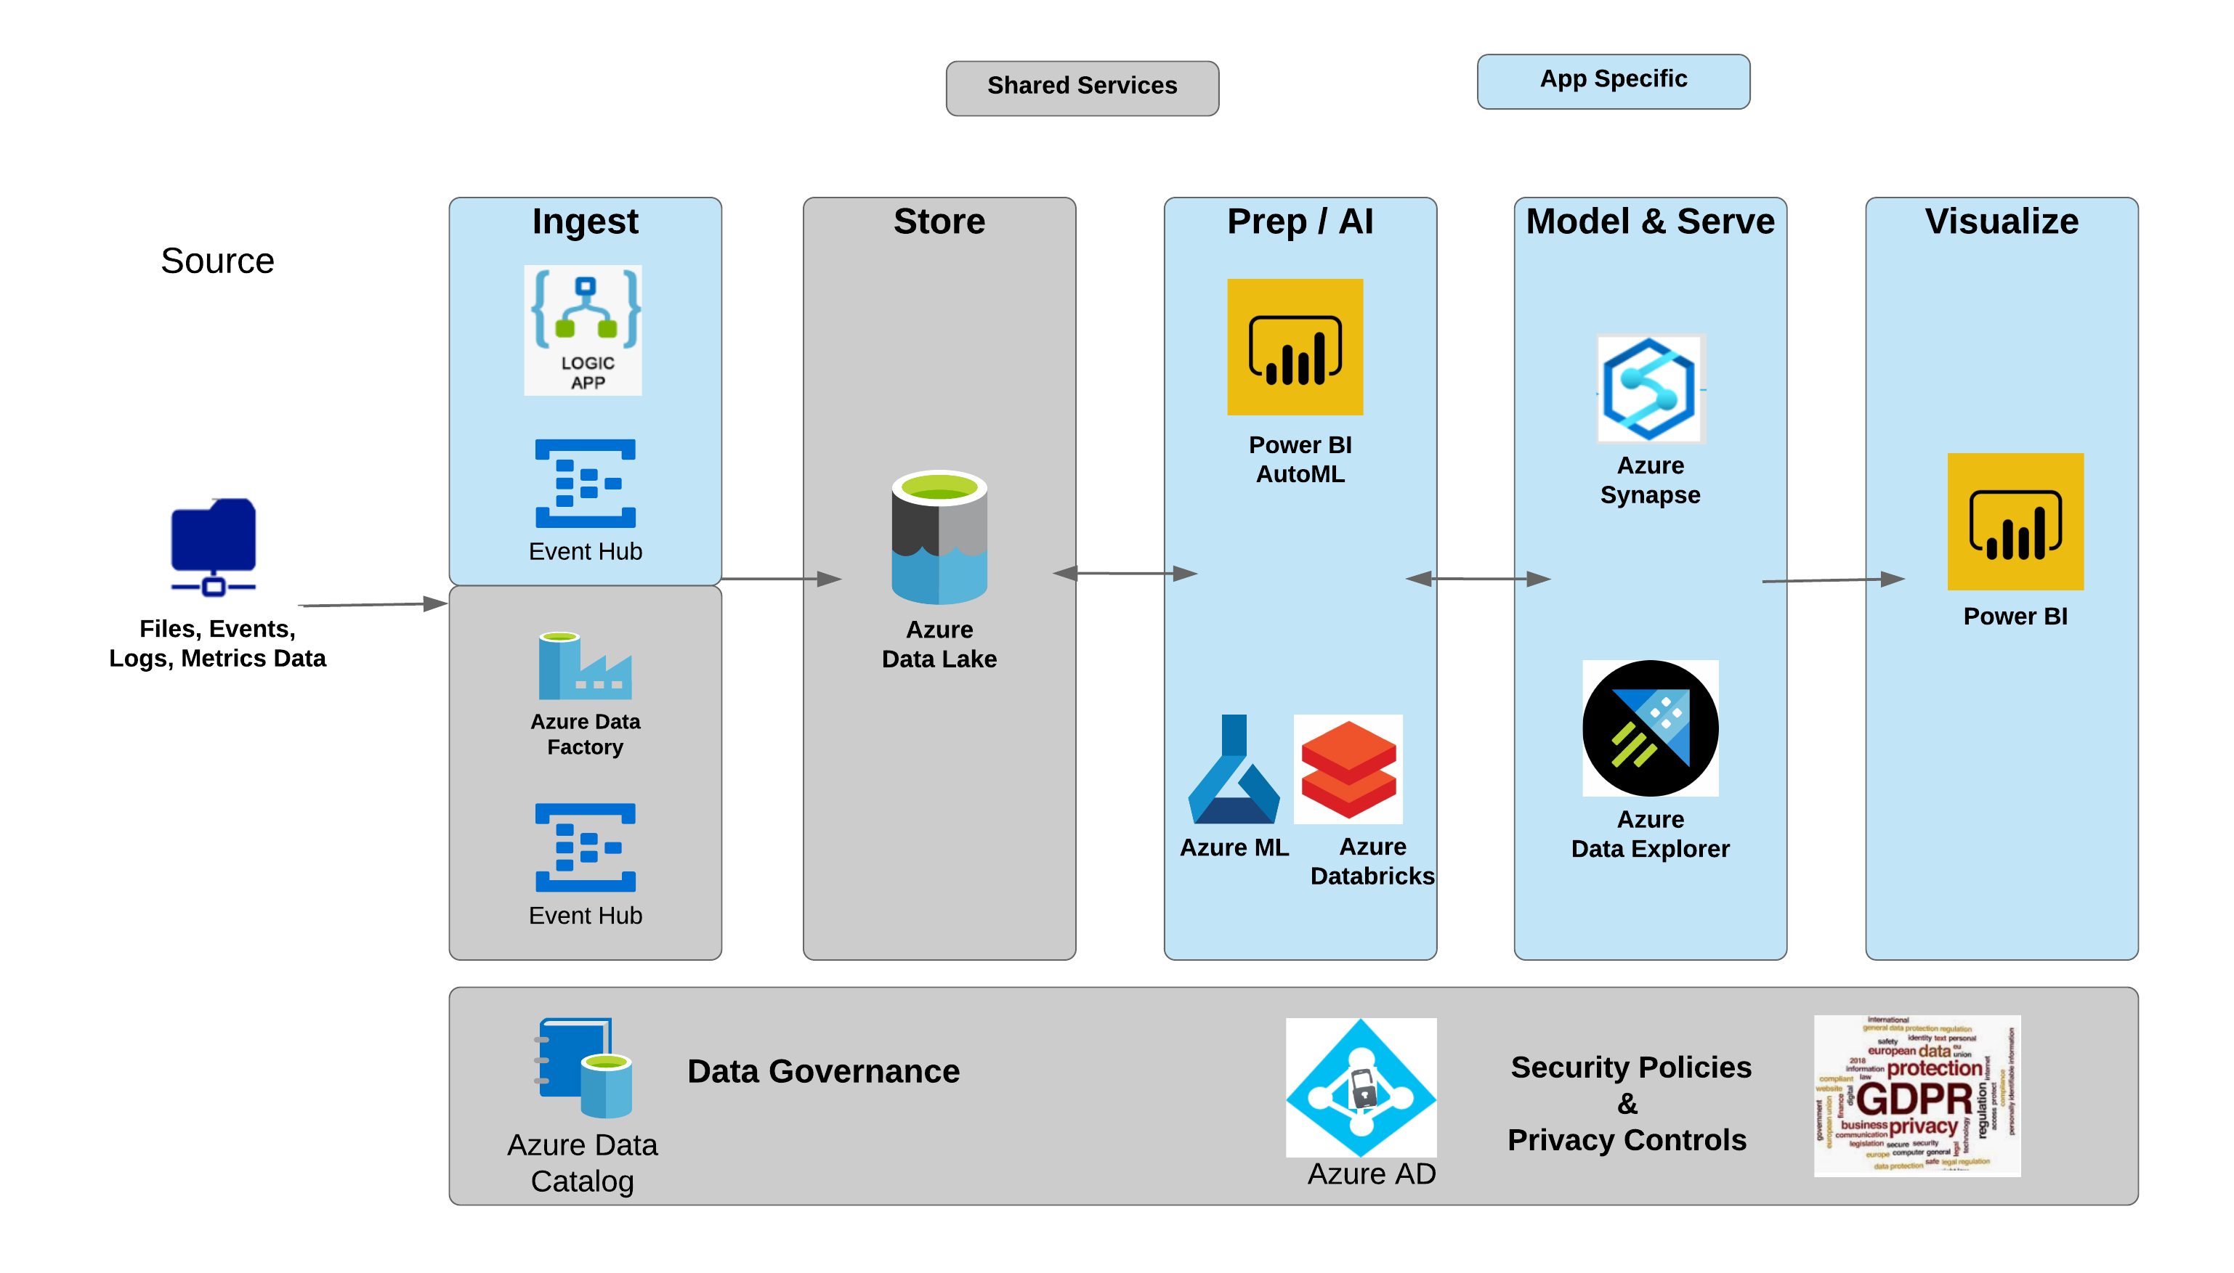

FUTURE STATE ARCHITECTURE
= Proposed Azure Service for GBHD
Volume and THROUGHPUT
Azure Functions
Volume
200 GB Hive warehouse
<100 Users
Pain Point
4-5 weeks to renegotiate the contract
Faster Contract Negotiation
Takes 4-5 weeks to renegotiate the contract under current setup

Slide 11
CURRENT VS FUTURE STATE MAPPING
Hadoop HortonWorks
Azure Databricks
HiveQL
Azure Databricks
Spark
Azure Databricks
HDFS
ADLS 2/ (Synapse Optional)
Talend
Azure Data Factory
Control M
Functions \ Azure Batch
Notes:
Synapse – Add that in the future state

Slide 12
ESTIMATES AND TIMELINE

Slide 13
TIMELINE - GBHD
Roadmap & Schedule
 | WORKSTREAM | AUG | SEP | OCT | NOV | DEC | JAN | FEB | MAR | APR | MAY
Phase 1 | Discovery (1-3 Week)
 | Implementation (Azure Data Lake)
 | Databricks Implementation
 | Automation
 | Data Migration
 | UAT / Go Live Ready
Phase 2 | ML Modeling
 | Data Visualization
Discovery
Data Lake
Databricks, Jobs, Scripts
Dev Ops
Data Migration
UAT
Go Live Ready
Predictive
Data Visualization
**SCOPE:
Azure Databricks setup / configured for data processing
Integrate EBI Jobs to Data Lake
Migrate the Data to Azure Data Lake Gen 2
Migrate from HiveQL to SparkSQL
Migrate all Talend jobs to Azure Data Factory
Notes:
Lift and Shift – look for the Data engineering efficiency. Predictive Modeling be ph-2

Slide 14
ACCENTURE RESOURCES - REQUEST
ROLES | ACTIVITIES | HOURS / COMMITMENT | WEEKS / UNITS | EST. HOURS
Technical Architect | Understanding exiting HortonWorks setup, Data Processing, Control M, Enterprise Automation standard, review, Static/ Dynamics Security code review, reviewing and approving architecture and Knowledge Transfer | 5 | 20 W | 100
Technical SME | Current Dashboard, Control M/ Schedule Job specific understanding (Backlog), Technical design, Integration points etc. | 20 | 6 W | 120
Sponsor (Yakuta Rasheed) | Dev Manager / Technical Product Owner | 5 | 20 W | 100
Infrastructure Engineer | Firewall rules, User Access, IP Ranges, creating Azure access points, Security Key Generation, Certs, available domain names, Network Architecture, Data Security, reviewing and approving architecture and changes | 20-30 | 1 | 20-30
Qlik Engineer | Integration with Databricks for Qlik apps | 20-30 | 1 | 20-30
EBI Engineer | Integration with ADLS/ ADF | 20-30 | 1 | 20-30

Slide 15
PROPOSED NEUDESIC TEAM
Leadership
DELIVERY MANAGER
TECHNICAL ARCHITECT
Development
DATA ENGINEER
DATA ENGINEER
devOps/ Testing
DEVOPS ENGINEER

Slide 16




NEUDESIC SERVICES ESTMMATE
DELIVERABLES
SCHEDULE
ESTIMATED COST
NEUDESIC TEAM
AZURE DATA PLATFORM
INGESTION SCRIPTS
TRANSFORMATION SCRIPTS
INTEGRATION WITH DOWNSTREAM APPs
BUILD, RELEASE PIPELINE AUTOMATION
18-20 WEEKS
MVP: ~$175-$200K
PART-TIME RESOURCES:
ENGAGEMENT MANAGER
TECHNICAL ARCHITECT
DEVOPS ENGINER
FULL-TIME RESOURCES:
SR. DATA ENGINEER (2)
*MICROSOFT INVESTMENT: TBD

Slide 17
Neudesic @ Accenture
Neudesic team executed a successful project with Accenture (Chella Murugapan) to migrate their AWS applications to Azure. The responsibilities included to assess and migrate the applications from.
Tasks included recommendation and implementation of environment configuration, AWS Lambda to Azure Functions porting, security, logging, authentication and rewriting the code as per the recommendations. Following was achieved
All task related to the architecture, implementation, coding, testing completed
Knowledge transfer was completed to train the Accenture support team to support the future work on these application
Documentation and backlogs were provided
4. Regular demo/ and status were provided through out the project

Slide 18
NEXT STEPS
Finalize plan: approach, scope and deliverables
Confirm technical architecture and pilot phase priority (define success criteria)
Identify (Accenture) team / resources and confirm commitments and availability
Resource (Neudesic) onboarding
Project Kickoff: August/ September?

Slide 19
THANK YOU!

